Slide 1

LEAVE YEAR END PROCESS
Presented By: W Mtembu

Slide 2
IMPORTANT TO NOTE:
Importance of accurate leave tracking for compliance and efficiency
Importance of auditing leave balances and ensuring they reflect accurate data
Importance of Leave Credit Calc
Importance of Line Managers to clear the leave inboxes
Importance of Leave Policy

Slide 3
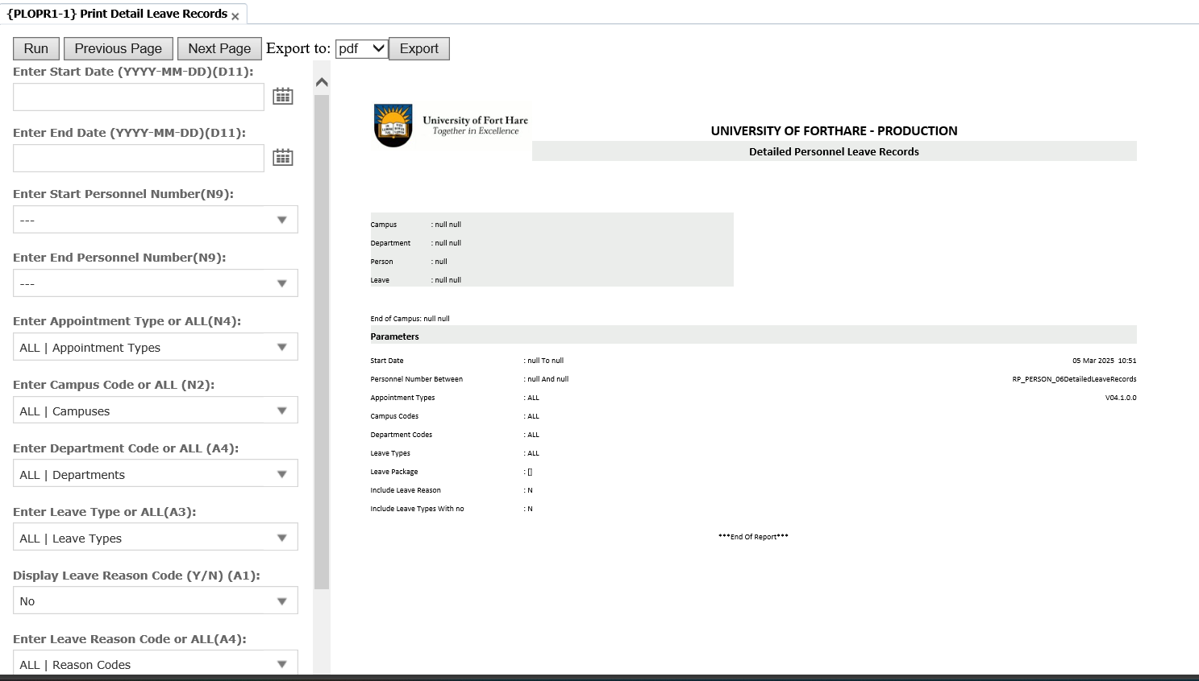
PLOPR1-1: LEAVE REPORT

Slide 4
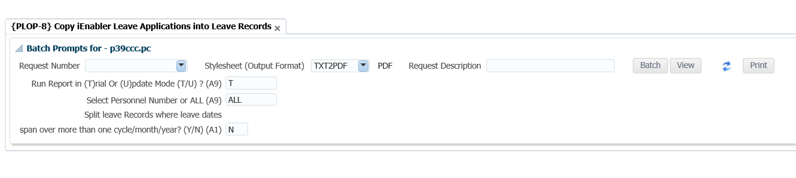
PLOP-8: COPY iENABLER LEAVE APPLICATION TO PRODUCTION

Slide 5
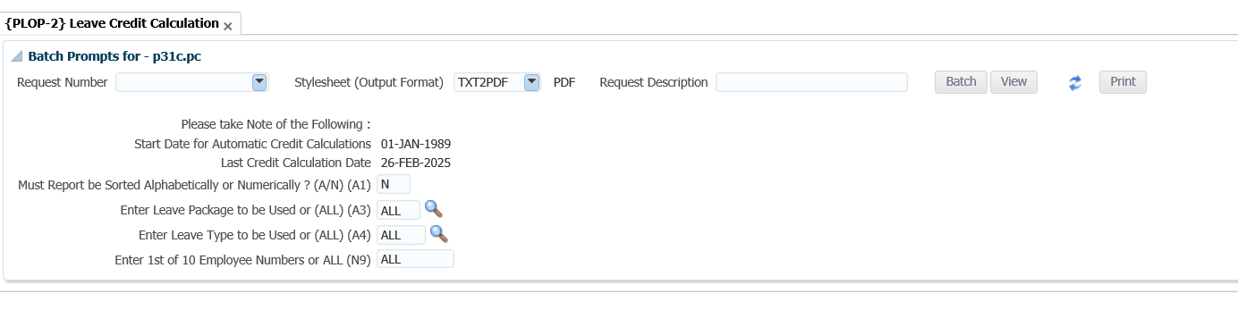
PLOP-2: LEAVE CREDIT CAL

Slide 6
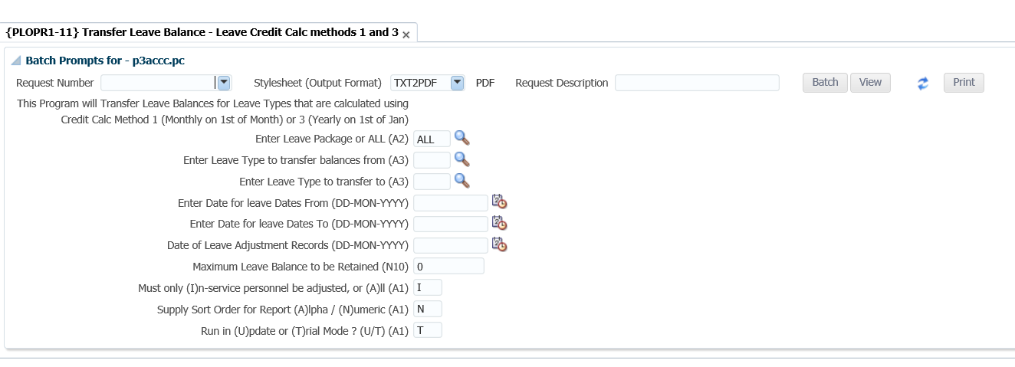
PLOPR1-11: TRANSFER LEAVE BALANCE

Slide 7
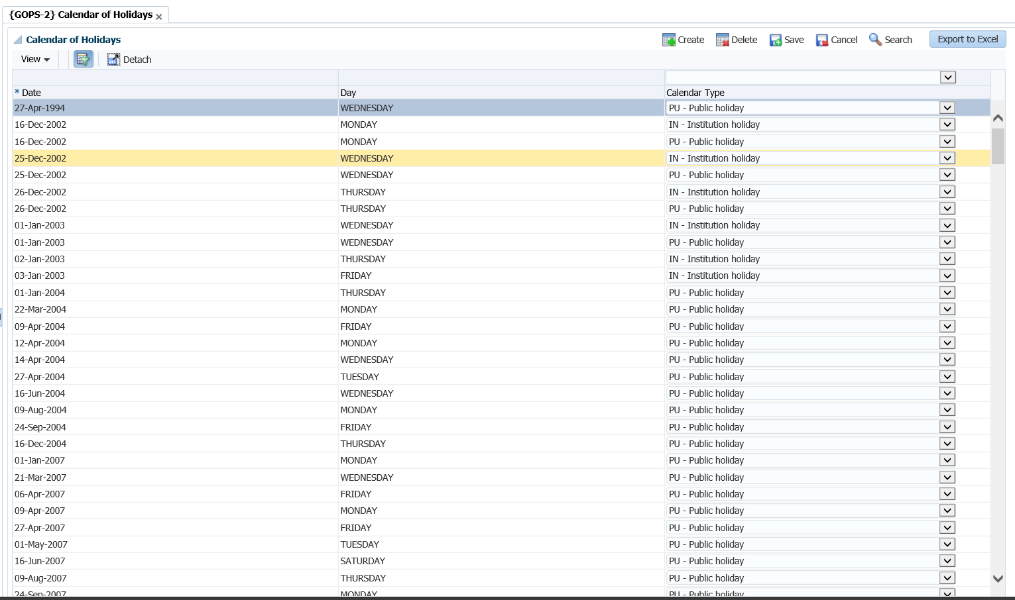
GOPS-2: SET THE SHUT-DOWN PERIOD AND UPDATE CALENDAR HOLIDAY

Slide 8
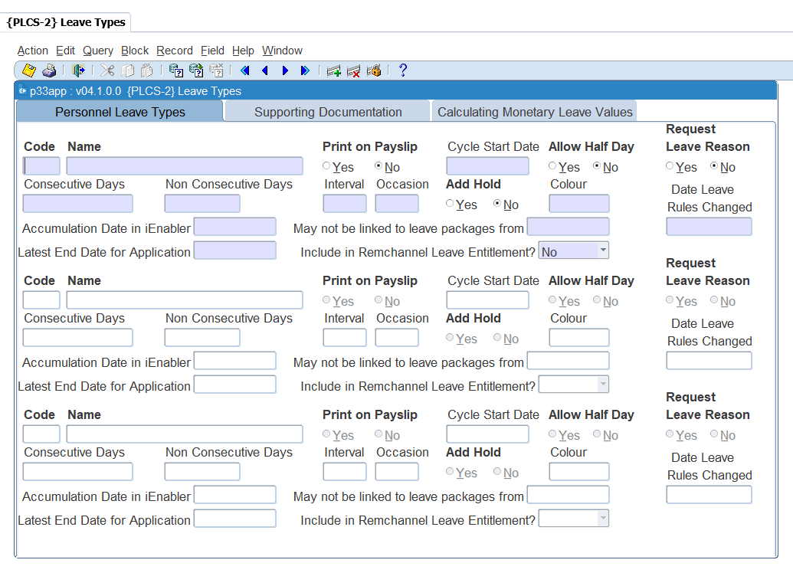
PLCS-2: UPDATE LEAVE TYPE TO RESPECTIVE YEAR

Slide 9
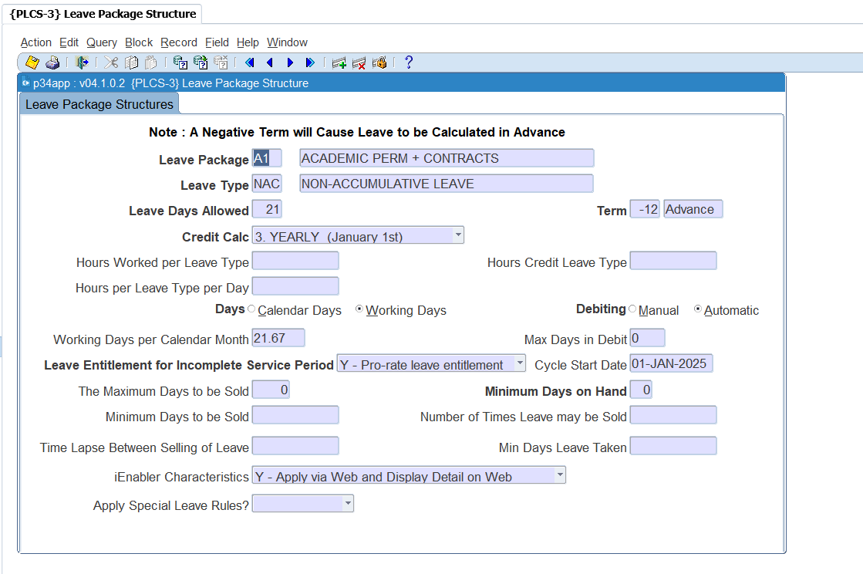
PLCS-3: UPDATE LEAVE PACKAGE CYCLE

Slide 10

THANK YOU

